Slide 1
Research on AGORA
Group-6 : Abhishek, Anushka, Rishitha

Slide 2
Research Question 1
RQ1: To what extent does modifying API specifications, such as variable types impact AGORA's ability to generate accurate and relevant test oracles for REST APIs?
Motivation: The motivation behind this is to help developers with insights that enable them to strategically modify their APIs to produce better test oracles

Slide 3
Methodology
Select APIs:
Spotify ( offset, limit, tracknumber)
Amadeus ( adults, room quantity)
Github ( Team-id)
Marvel ( comic_id, available)
2. Modification of OAS Specifications
3. Generation of New Declarations and Dtrace Files
4. Generation of New Invariants (CSV)
5. Comparison and Analysis

Slide 4
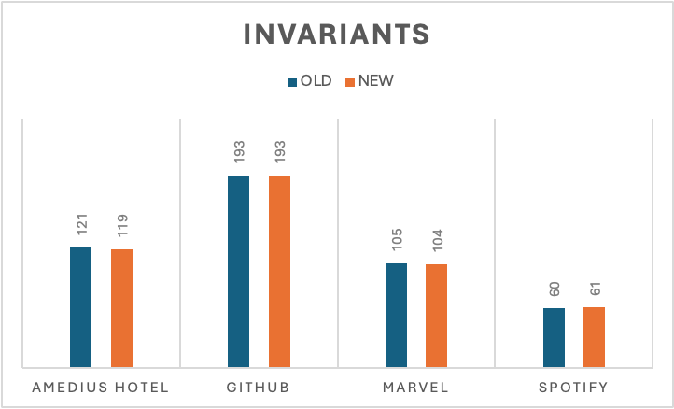
Findings
Number of Invariants
After examining the data, we noticed that for three out of the four APIs, there was a reduction in the number of invariants following the data type modification.

Slide 5
Findings
B. Difference in the Invariants
To delve deeper into the analysis, we conducted a comparison of the invariants themselves before and after the data type change. This involved using Excel's VLOOKUP operation to identify any missing or newly introduced invariants.

Slide 6

AmadeusHotel API
we observed that two invariants were absent in the new CSV compared to the old one.

Slide 7
Marvel API
Old :
New :
Lost :

Slide 8




Spotify API
Old :
New :
Old2 :
New2 :

Slide 9
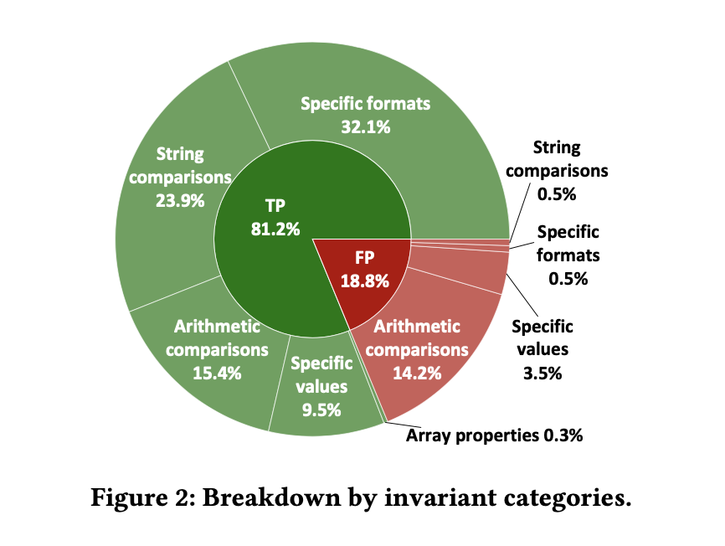
Findings
“The largest portion of false positives (75.8%) were found in the arithmetic comparison category”.
Decrease in arithmetic comparison when Int —-> String
This observation suggests that altering data types can effectively reduce arithmetic comparisons, thereby indirectly reducing false positives.

Slide 10
Research Question 2
RQ2: How do changes in black-box test case generators, specifically transitioning from RESTest to alternative tools such as RESTler and RESTTestGen affect the patterns and quality of invariants detected in REST API testing?
Motivation: This study aims to provide developers and testers with valuable insights into selecting the most appropriate tool for their testing needs, ultimately leading to the development of more reliable and high-quality APIs.

Slide 11
Methodology:
Initial approach was:
OAS specification to generate test cases from Restest.
Microsoft’s restler-fuzzer to generate test cases which can be fed to beet.
Generate test cases from Restestgen.
We will compare the invariants generated by all three backbox testers and analyze the result.
Notes:
Initially, our approach to addressing Research Question 2 was guided by the assumption that Restest would seamlessly fulfill our testing needs. However, this assumption was challenged when we encountered an unexpected issue related to the groovy dependency in Maven, despite our prior testing with various versions of Restest across different platforms such as MACOS and Windows, utilizing JDK versions including JBR 17, JDK 17, and OpenJDK 21. This setback prompted a reassessment of our strategy, leading us to explore alternative avenues for fulfilling our testing requirements."

Slide 12
Challenges
Encountered groovy dependency issue in Maven with Restest.
Tested Restest versions 1.2.0, 1.3.0, 1.4.0 on MACOS and Windows with JDK 17, JBR 17, and OpenJDK 21.
To overcome this obstacle, we opted to focus solely on APIs for which Restest outputs were already available.

Slide 13
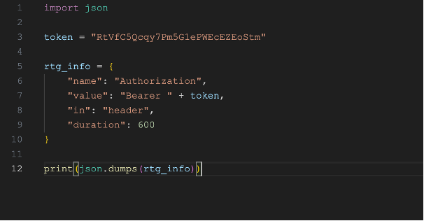
Challenges
2. Authentication Issues with Restler and Restestgen
Restler : While Marvel and Amadeus required complex authentication methods, OMDB simply required passing the API key as a query variable. Adapting Restler's grammar to accommodate query-based authentication proved necessary, although the functional correctness of this approach remains unverified.
Restestgen :

Slide 14
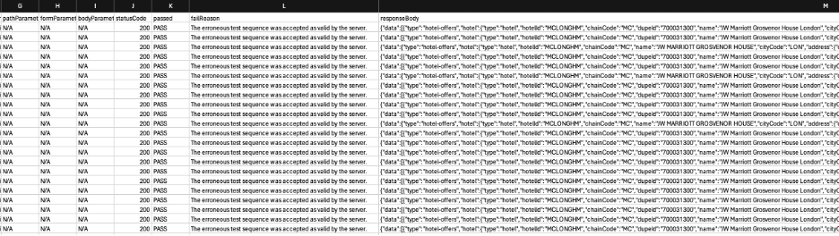
Challenges
3. Integration of restler and restestgen with beet
However, we were able to generate csv files of the API’s but the problem lied in sending the input to beet to produce datatrace file.
Converted JSON files to CSV format using Python script
Modifying Beet.

Slide 15
Thank You
Github- https://github.com/medhyaj/AGORA_project
Trello- https://trello.com/b/jhzWxNJB/project-group6

